Slide 1
2026 School Planning

Slide 2
2026 School Planning
Welcome
Agenda
    Presentation
    Q & A
    Gather feedback
    Meeting evaluation

Slide 3
2026 School Planning
The purpose of this meeting is to:
  Share information about school planning at Erin Woods School
  Gather feedback that may be considered in making future school planning decisions

Slide 4
How is Our School Development
Plan Used?
Guides ongoing assessment and review of goals and actions.
Our school development plan is the driver for closing learning gaps and informs:
    Instructional strategies
    Professional learning
    School structures and processes for learning
    Resources to improve student learning
    Data-informed decision making
Notes:
Establishing and posting the plan is just the beginning. Staff work throughout the year to implement the actions and achieve the goals identified in the school development plan. Part of that work is also making sure actions are visible to the school community, including parents. Throughout the year, the school development plan will inform many aspects of our work, such as:
Instructional strategies
Professional learning
School structures and processes for learning
Resources to improve student learning
Data-informed decision making

Slide 5
School Development Plan –
School Goal
School Goal:
  Student foundational skills in literacy and mathematics will improve
Outcomes:
  Students will improve in reading comprehension through vocabulary development
  Students will improve in engaging and representing understanding through rich mathematical discourse

Slide 6
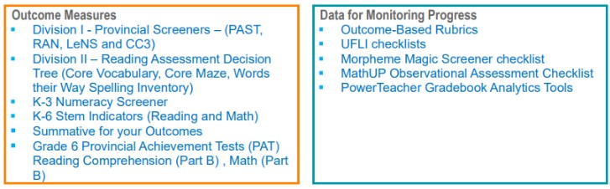
School Development Plan –
Outcome Measures & Data for Monitoring

Slide 7
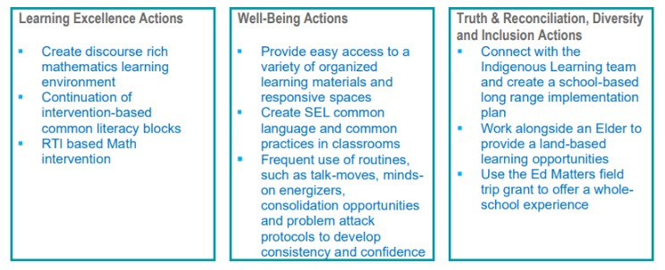
School Development Plan –
Actions

Slide 8
Questions?
We’ll take a few minutes to answer questions about our school development plan.
Notes:
Pause at this slide until your Q&A is finished.
You may want to remind participants that this Q&A is to clarify anything that was unclear in the presentation up to this point and that there will be an opportunity to provide feedback after the presentation.
It is recommended that someone keeps time.

Slide 9
Our School Budget
Our school received $3,287,364 in 2025-26 to provide a quality education to our students and meet the goals in our school development plan (SDP).
At least 75 per cent of budgeted funds covers staffing and the remaining portion covers instructional and operational supplies.
Notes:
Most aspects of a school development plan are independent of the school budget. However, budget may affect how we implement a school development plan. For instance, if a school development plan identifies English language learning as the focus, the school could elect to allocate part of their budget to hiring a teacher to support English language learners and build teacher capacity in this area. In other cases, schools may also consider parent fundraising to enrich supports currently available (e.g., expand the collection of dual language books in the school’s learning commons).
The vast majority of funding goes to staffing. The remaining portion pays for supplies and other resources.
[Add more detail about the instructional and operational supplies at your school.]

Slide 10
Our 2025-26 School Budget
Our student enrolment for the current year is 376.
RAM Allocations
Per School Total |  | $ 1,313.064
Per Student Total |  | $ 1,974,300
Total RAM Allocations |  | $ 3,287,364
RAM Deployment | Scenario A
Organization |  | FTEs
Teachers | $ 2,244,387 | 20.2
Support Staff | $ 512,168 | 8.1
Administration | $ 392,947 | 4.4
Total Staffing | $ 3,149,502 | 32.7
Supplies/Other | $ 137,862
Total RAM Deployment Plans | $ 3,287,364

Slide 11
Our 2025-26 School Fees
We will consult with families by outlining proposed activities for the upcoming year that may require a fee for cost recovery.
Field Trips
  Swimming Lessons
  Telus Spark
  Confluence
  Inglewood Bird Sanctuary
  Camp Chief Hector (2026-27)
Notes:
You may want to discuss some of the following topics:
How fees, fundraising and budget are interconnected.​
How parent society fundraising $s were used to lower/eliminate some fees​
What the major categories of fees were at the school​
School-based fees vs. central CBE fees (e.g., transportation, noon supervision)​
Average fee per student (per grade?)
Differences when compared with last year’s school fees

Slide 12
Our 2025-26 School Fees
§ Guide to 2025-26 School Fees
Notes:
This is the list of approved school fees for 2025-26. In August, the fees for the 2026-27 school year will be posted.
School fees are only charged to cover the cost of an activity. Based on what we know at this time, fees for 2026-27 will be similar to what you see for this year. You may see an increase in fees where the cost of an activity (or a material associated with the activity) has increased.
[Customize for your school context. Based on what you know at this point in time, discuss any possible new, increasing or decreasing fees for 2026-27. Make sure you express the rational for any possible changes in fees.]

Slide 13
Our 2025-26 School Fees
2024-25 Report to Parents on Fees

Slide 14
Questions?
We’ll take a few minutes to answer questions about our school budget and fees.
Notes:
Pause at this slide until your Q&A is finished.
You may want to remind participants that this Q&A is to clarify anything that was unclear in the presentation up to this point and that there will be an opportunity to provide feedback.
It is recommended that someone keeps time.

Slide 15
Gathering Your Feedback
Feedback is important as we consider school planning. When students, families and staff work closely together, students achieve greater success in their learning.
We’d now like to gather your feedback on some specific questions.

Slide 16
Gathering Your Feedback
School Development Plan (SDP)
We share SDP information and updates in different ways. In what ways have you learned about our SDP?
School website
School council meeting
Other

Slide 17
Gathering Your Feedback
School Budget & Fees
Schools must operate within their budget and too many fees can be unmanageable for families. Knowing that, what activities and services are most important to you?
(e.g., field trips, guest speakers, experts in schools, sporting activities, outdoor education, etc.)

Slide 18
Next Steps
We will update our school website with:
    A summary of feedback gathered at tonight’s session by April 9th
    A meeting evaluation summary by April 9th
    Share information about student results and the school development plan at our September 2026 school council meeting.
    Our updated school development plan will be posted on our school website by Nov. 30, 2026.

Slide 19

Wrap-Up
Thank you for your participation!
Please take a few minutes at this time to share your feedback about this meeting.
Notes:
We want to make sure our meetings meet your needs and expectations. That's why we are asking for your feedback on this meeting. Your feedback is the only way we will know what we're doing well and what we can improve at future meetings. So please do take a few minutes to share your feedback. We will share a summary of responses on our website later this spring.

